Slide 1
Software Design
Lecture 3

Slide 2
Content
Architectural Patterns
Layers
Client-Server
Event-driven
Broker
Mediator
MVC (and variants)

Slide 3
References
Books
Mark Richards, Software Architecture Patterns, O’Reilly, 2015 [SAP]
Taylor, R., Medvidovic, N., Dashofy, E., Software Architecture: Foundations, Theory, and Practice, 2010, Wiley [Taylor]
F. Buschmann et. al, PATTERN-ORIENTED SOFTWARE ARCHITECTURE: A System of Patterns, Wiley&Sons, 2001.[POSA]
Artem Syromiatnikov, A Journey Through the Land of Model-View-* Design Patterns, MSc Thesis, 2014.
Reid Holmes, MVC/MCP, Univ. of Waterloo course materials
Online resources
O. Shelest, MVC, MVP, MVVM design patterns,
http://www.codeproject.com/KB/architecture/MVC_MVP_MVVM_design.aspx
http://www.tinmegali.com/en/model-view-presenter-mvp-in-android-part-2/
https://academy.realm.io/posts/mvc-vs-mvp-vs-mvvm-vs-mvi-mobilization-moskala/
https://www.infoq.com/articles/no-more-mvc-frameworks?utm_source=infoq&utm_campaign=user_page&utm_medium=link
Univ. of Aarhus Course Materials
Univ. of Utrecht Course Materials

Slide 4
Last time
GRASP
Package design principles
Cohesion
Coupling

Slide 5
Architectural Patterns
Definition
An architectural pattern expresses a fundamental structural organization schema for software systems. It provides a set of predefined subsystems, specifies their responsibilities, and includes rules and guidelines for organizing the relationships between them.
[POSA, vol.1]
Different books present different taxonomies of patterns

Slide 6
Structural AP
From Mud to Structure
Direct mapping Requirements -> Architecture?
Problems: non-functional qualities like portability, stability, maintainability, understandability…

Slide 7
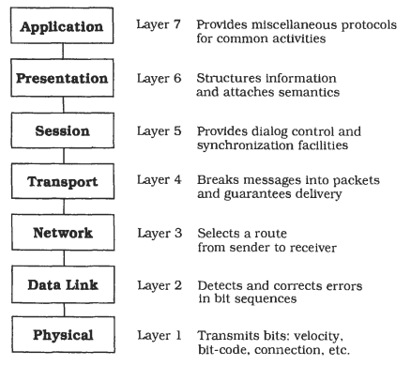
Layers
Definition
The Layers architectural pattern helps to structure applications that can be decomposed into groups of subtasks in which each group of subtasks is at a particular level of abstraction.
Example
Networking: OSI 7-Layer Model

Slide 8
Layers AP
Addressed problems
High-level and low-level operations
High-level operations rely on low-level ones
Vertical structuring
Several operations on the same level on abstraction but highly independent
Horizontal structuring

Slide 9
Constraints
Late source code changes should not ripple through the system.
Interfaces should be stable and may even be prescribed by a standards body.
Parts of the system should be exchangeable.
It may be necessary to build other systems at a later date with the same low-level issues as the system you are currently designing.

Slide 10
Constraints [2]
Similar responsibilities should be grouped to help understandability and maintainability.
There is no 'standard' component granularity.
Complex components need further decomposition.
The system will be built by a team of programmers, and work has to be subdivided along clear boundaries.

Slide 11
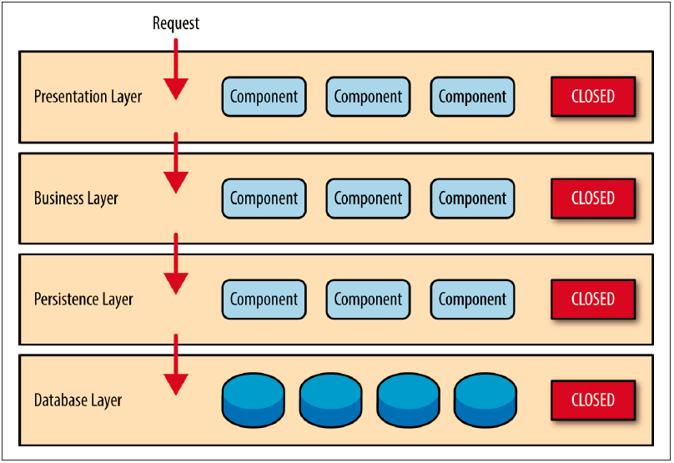
Key concepts
Closed layers
Layers of isolation:
changes made in one layer of the architecture don’t impact components in other layers

Slide 12
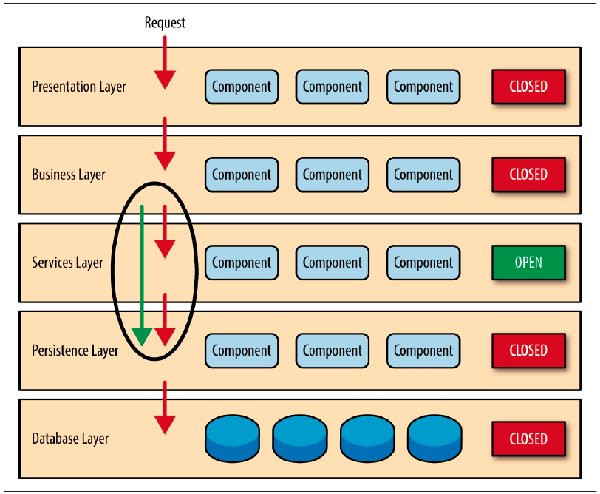
Variants
Relaxed layered system

Slide 13
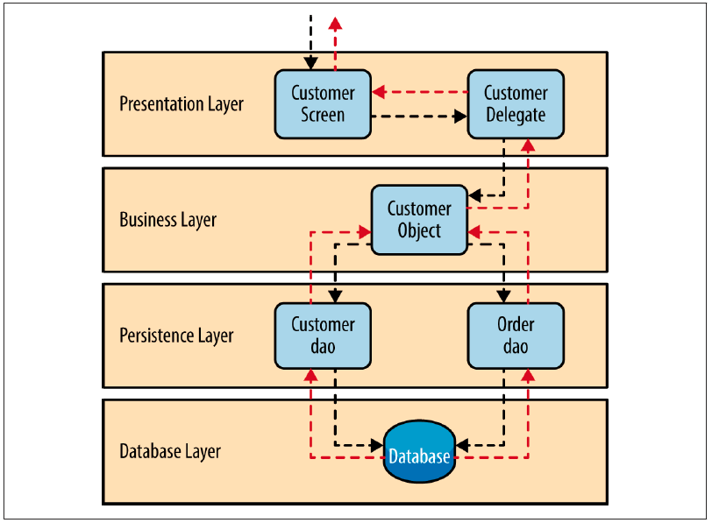
Example
Customer Screen:
Java Server Faces
ASP (MS)
Customer Delegate:
managed bean component
Customer Object:
Local Spring Bean
Remote EJB3 component
C# (MS)
DAOs:
POJOs
MyBatis XML Mapper files
Objects encapsulating raw JDBC calls or Hibernate queries
ADO (MS)

Slide 14
Implementation steps
Define abstraction criterion for grouping tasks into layers
Determine number of abstraction levels
Name the layers and assign tasks to each of them
Specify services (from a layer to another)
Refine layering (iterate steps above)
Specify interface for each layer
Structure individual layers
Specify communication between adjacent layers
Decouple adjacent layers (callbacks for bottom-up)
Design error-handling strategy

Slide 15
Considerations
Sink-hole anti-pattern
requests flow through multiple layers of the architecture as simple pass-through processing with little or no logic performed within each layer.
Non functional req. | Rating
Overall agility | Low
Ease of deployment | Low
Testability | High
Performance | Low
Scalability | Low
Ease of development | High

Slide 16
Consequences
Benefits
Reuse of layers
Support for standardization
Local dependencies
Exchangeability
Liabilities
Lower efficiency
Increased design effort
Difficulty of establishing the correct granularity of layers

Slide 17
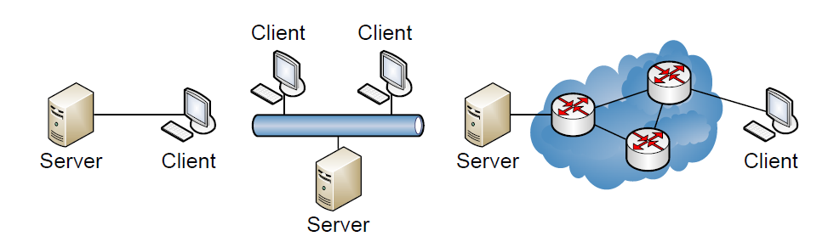
Client-Server
Partition tasks and workload between provider of a resource (server) and requester (client)
Client does not share resources
Server hosts one or more server programs

Slide 18
Structure
Server
Provides function or service
E.g. web server, web page, file server
Can service multiple clients
Client
Consumes services
Interacts with server to retrieve data
Must understand response based on application protocol
Both can process data

Slide 19
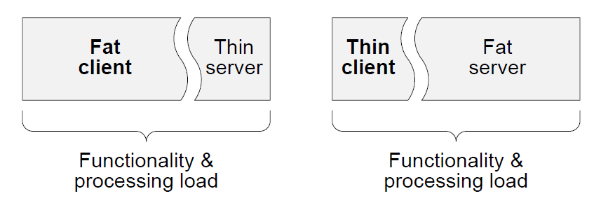
Types of servers and clients
Servers
Iterative (UDP-based servers, ex. Internet services like echo, daytime)
Concurrent (TCP-based servers, ex. HTTP, FTP)
Thread-per-client
Thread pool
Clients
Thin
Fat

Slide 20
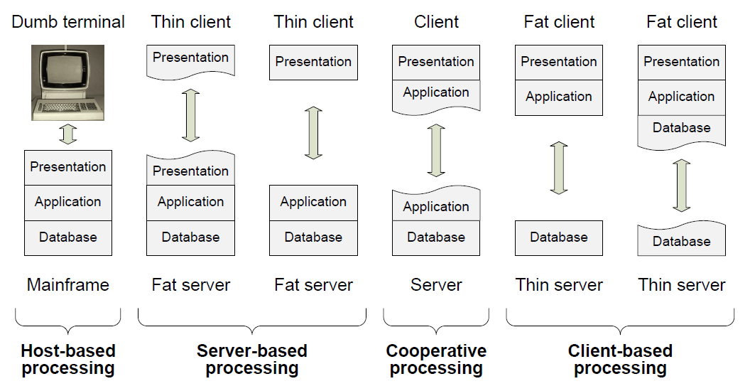
Layers vs. tiers
Layers – logical (ex. presentation, business logic, data access)
Tiers – physical

Slide 21
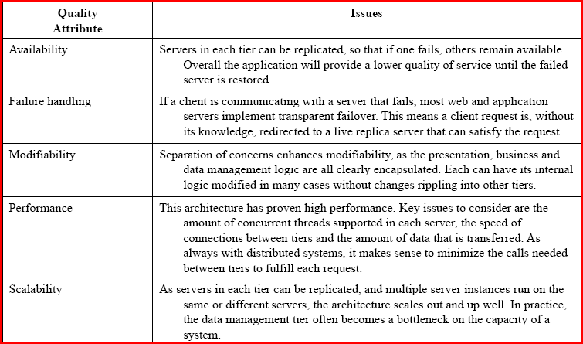
Considerations

Slide 22
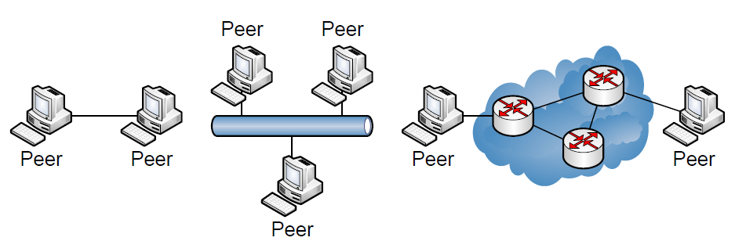
Peer-to-Peer
State and behavior are distributed among peers which can act as either clients or servers.
Peers: independent components, having their own state and control thread.
Connectors: Network protocols, often custom.
Data Elements: Network messages

Slide 23
Peer-to-Peer [2]
Topology: Network (may have redundant connections between peers); can vary arbitrarily and dynamically
Supports decentralized computing with flow of control and resources distributed among peers.
Highly robust in the face of failure of any given node.
Scalable in terms of access to resources and computing power.
Drawbacks:
Poor security
Nodes with shared resources have poor performance

Slide 24
Event-driven (distributed) architectures
(Distributed) asynchronous architecture pattern
Highly scalable applications
Highly adaptable by integrating highly decoupled, single-purpose event processing components that asynchronously receive and process events
2 main topologies
Broker
Mediator

Slide 25
Broker
Definition
The Broker architectural pattern can be used to structure distributed software systems with decoupled components that interact by remote service invocations. A broker component is responsible for coordinating communication.
Example
SOA

Slide 26
Broker
Context
The environment is a distributed and possibly heterogeneous system with independent, cooperating components.
Problems
System = set of decoupled and inter-operating components
Inter-process communication
Services for adding, removing, exchanging, activating and locating components are also needed.

Slide 27
Forces
Components should be able to access services provided by others through remote, location-transparent service invocations.
You need to exchange, add, or remove components at run-time.
The architecture should hide system- and implementation-specific details from the users of components and services.

Slide 28

Non-distributed system [MSDN]

Slide 29
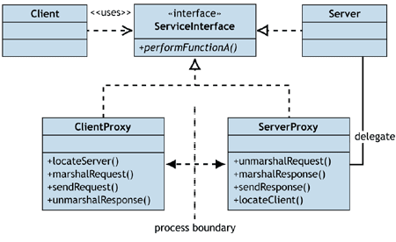
Distributed System [MSDN]

Slide 30
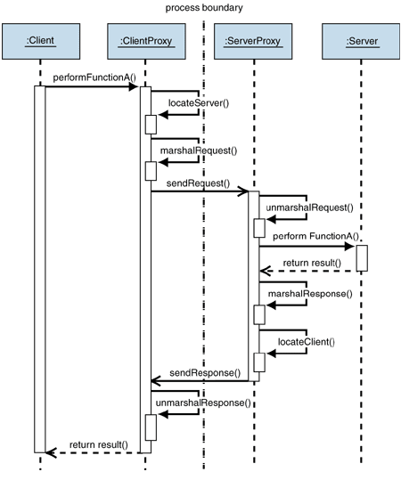
Distributed System – Problems?

Slide 31
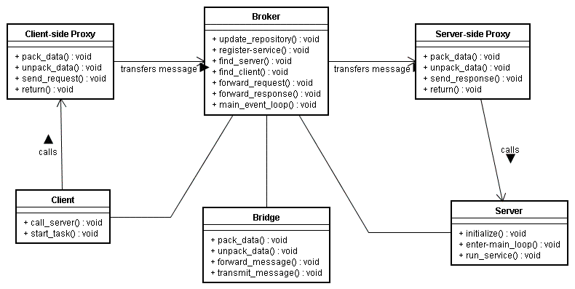
Solution

Slide 32
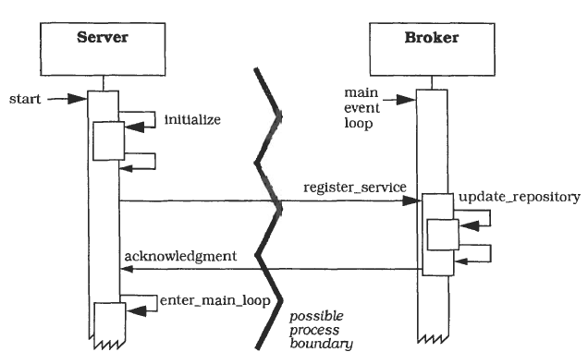
Scenario I – Server registration

Slide 33
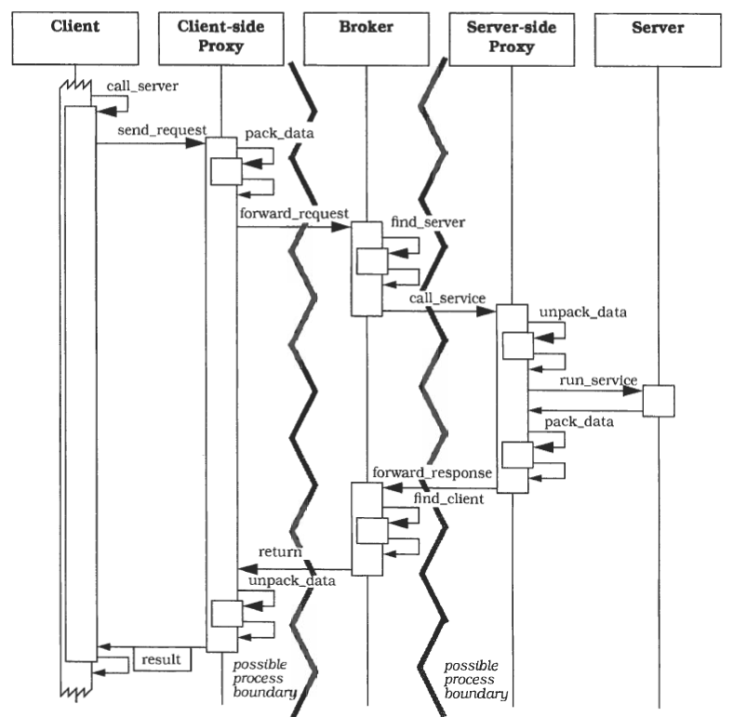
Scenario II – Broker connecting Client and Server

Slide 34
Scenario III – Bridge connecting Brokers

Slide 35
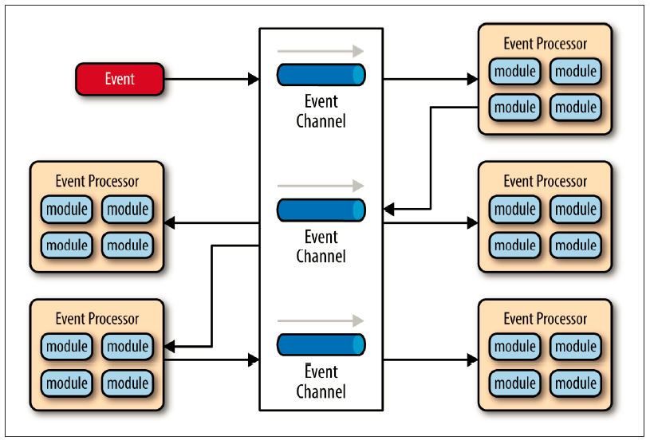
Event-driven perspective

Slide 36
Consequences
Benefits
Location transparency
Changeability and extensibility of components
Portability of a Broker System
Interoperability between Broker Systems
Reusability
Liabilities
Reliability – remote process availability, lack of responsiveness, broker reconnection
Lack of atomic transactions for a single business process

Slide 37
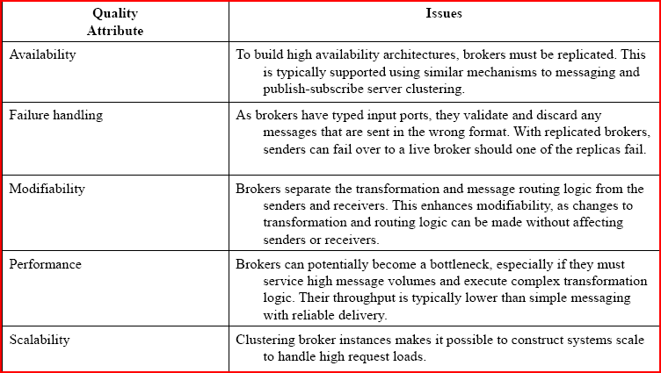
Considerations

Slide 38
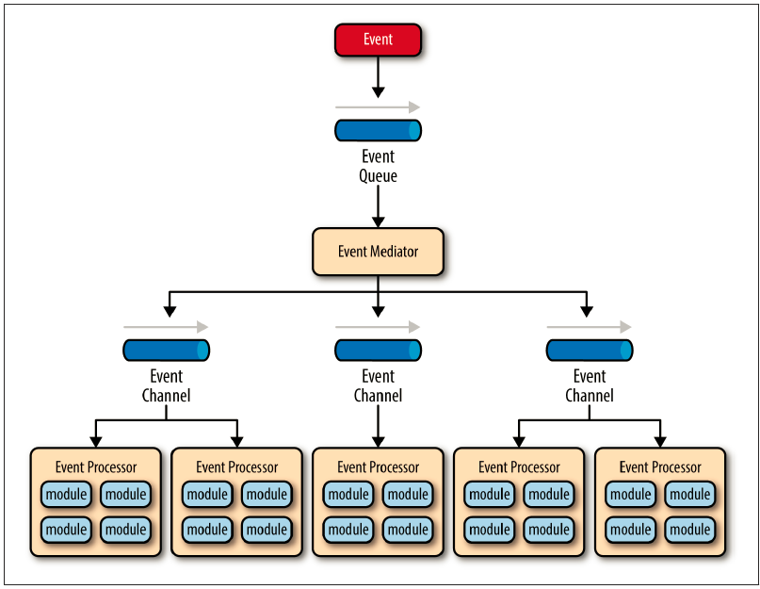
Mediator
for events that have multiple steps and require some level of orchestration to process the event

Slide 39
Components
Event queue (hosts initial events)
Message queue
Web service endpoint
Events
Initial
Processing
Event channel (passes processing events)
Message queue
Message topic
Event processor
self-contained, independent, highly decoupled business logic components

Slide 40
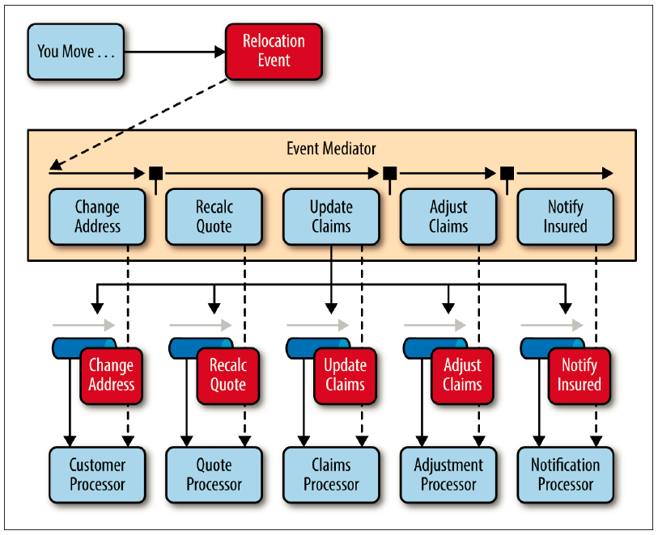
Event mediator
open source integration hubs such as Spring Integration, Apache Camel, or Mule ESB
BPEL (business process execution language) coupled with a BPEL engine (ex. Apache ODE)
business process manager (BPM) (ex. jBPM)

Slide 41
Interactive Systems
Context
Interactive applications with a flexible human-computer interface.
Problem
User interfaces are especially prone to change requests.
Different users place conflicting requirements on the user interface.

Slide 42
MVC
Solution
3 areas: handle input, processing, output
The Model component encapsulates core data and functionality (processing).
View components display information to the user. A view obtains the data from the model (output).
Each view has an associated Controller component. Controllers handle input.

Slide 43
MVC
Constraints
The same information is presented differently in different windows, for example, in a bar or pie chart.
The display and behavior of the application must reflect data manipulations immediately.
Changes to the user interface should be easy, and even possible at run-time.
Supporting different 'look and feel' standards or porting the user interface should not affect code in the core of the application.

Slide 44
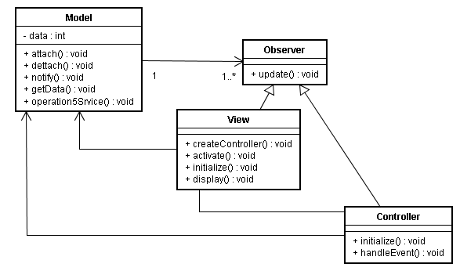
MVC Structure

Slide 45
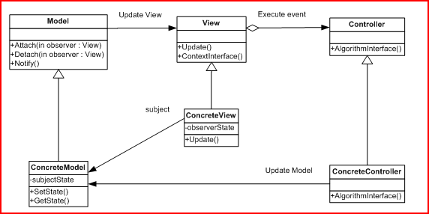
MVC more detailed

Slide 46
The Model
The model encapsulates and manipulates the domain data to be rendered
The model has no idea how to display the information is has nor does it interact with the user or receive any user input
The model encapsulates the functionality necessary to manipulate, obtain, and deliver that data to others, independent of any user interface or any user input device

Slide 47
The View
A View is a specific visual rendering of the information contained in the model (graphical, text-based).
Multiple views may present multiple renditions of the data in the model
Each view is a dependent of a model
When the model changes, all dependent views are updated

Slide 48
The Controller
Controllers handle user input. They “listen” for user direction, and handle requests using the model and views
Controllers often watch mouse events and keyboard events
The controller allows the decoupling of the model and its views, allowing views to simply render data and models to simply encapsulate data
Controllers are “paired up” with collections of view types, so that a “pie graph” view would be associated with its own “pie graph” controller, etc.
The behavior of the controller is dependent upon the state of the model

Slide 49
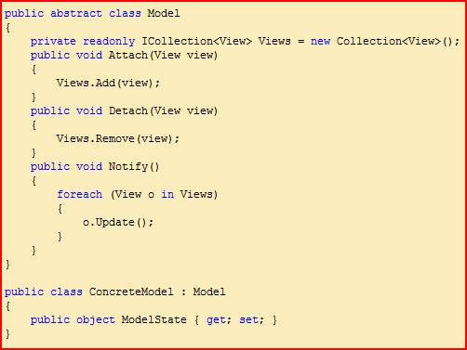
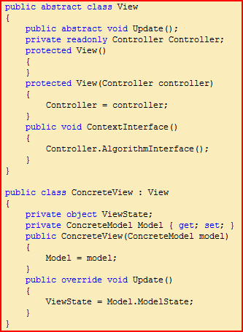
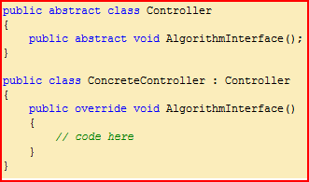
MVC Code

Slide 50
How does this work?
The model has a list of views it supports
Each view has a reference to its model, as well as its supporting controller
Each controller has a reference to the view it controls, as well as to the model the view is based on. However, models know nothing about controllers.
On user input, the controller notifies the model which in turn notifies its views of a change
Changing a controller’s view will give a different look.
Changing a view’s controller will give a different feel.

Slide 51
Scenario I – Creating the M,V,C objects

Slide 52
Scenario II – Event handling

Slide 53
Consequences
Benefits
Multiple views of the same model.
Synchronized views.
'Pluggable' views and controllers
Exchangeability of 'look and feel'.
Framework potential.
Liabilities
Increased complexity.
Potential for excessive number of updates.
Intimate connection between view and controller.
Close coupling of views and controllers to a model
Inefficiency of data access in view.
Inevitability of change to view and controller when porting.

Slide 54
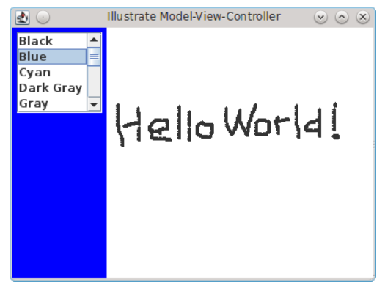
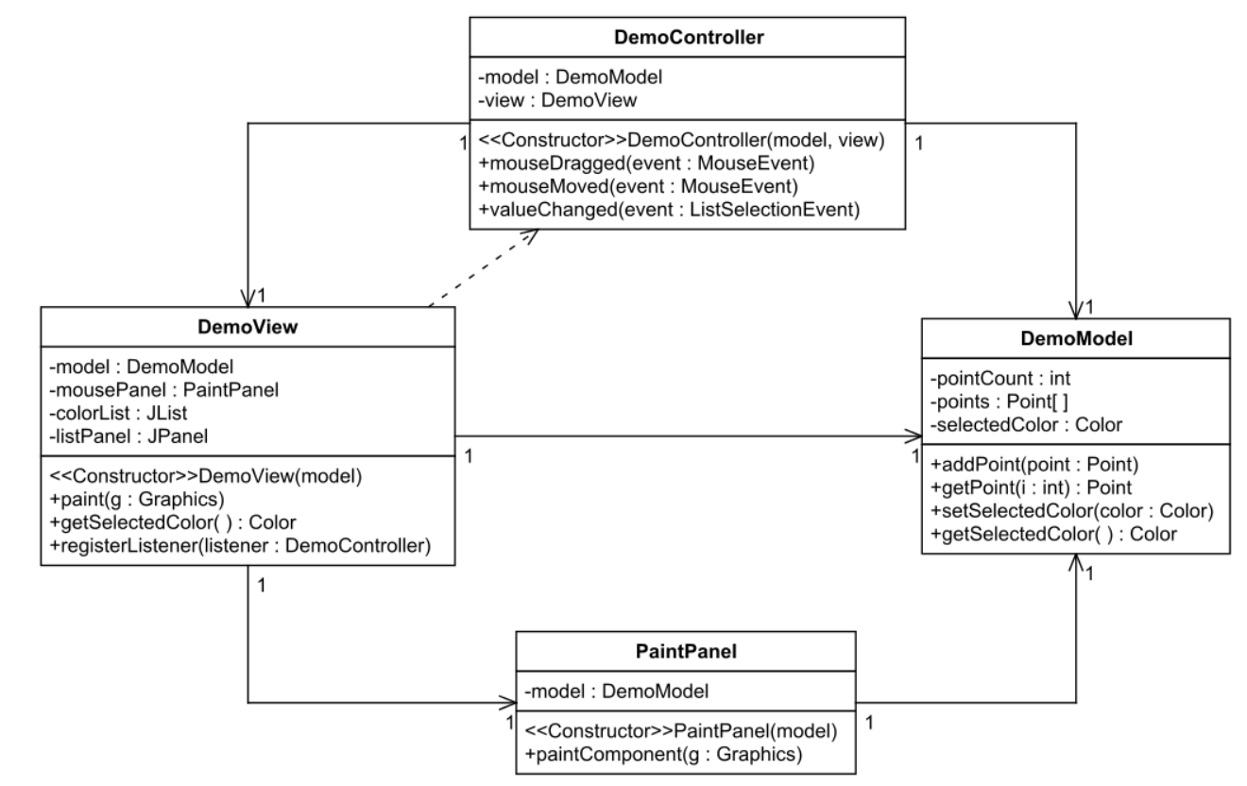
MVC Example

Slide 55
MVP
Intent
Separation between
Data
Business Logic
UI
Enforce single responsibility: M-V-P
Reduce coupling
Facilitate isolated testing

Slide 56
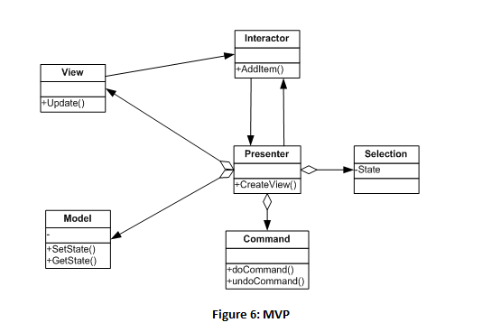
MVP Structure

Slide 57
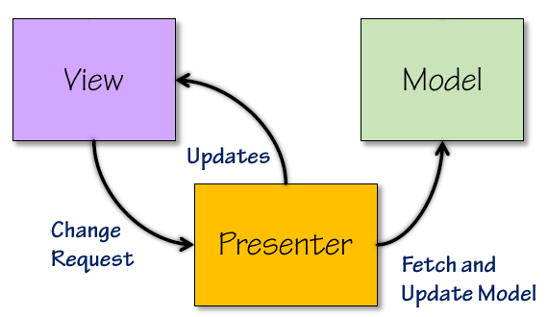
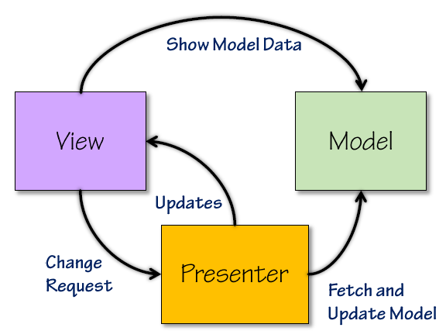
Variants
View and Model are decoupled
Presenter coordinates events
between View and Model
Passive View
View and Model no longer separated
Presenter coordinates events
between View and Model
Model contains only what View needs
Presenter interacts with Domain
Layer/Data Access

Slide 58
MVP Responsibilities
Model
Holds data to be displayed by View
View
Instantiate Presenter
Ask Presenter to do work
Could have reference to Model
Presenter
Responds to View Requests
May know when data is updated
Update View

Slide 59
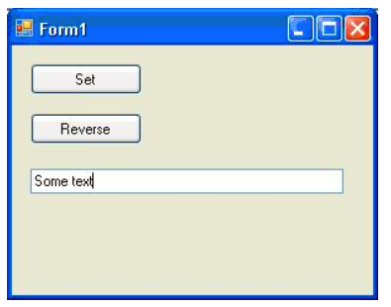
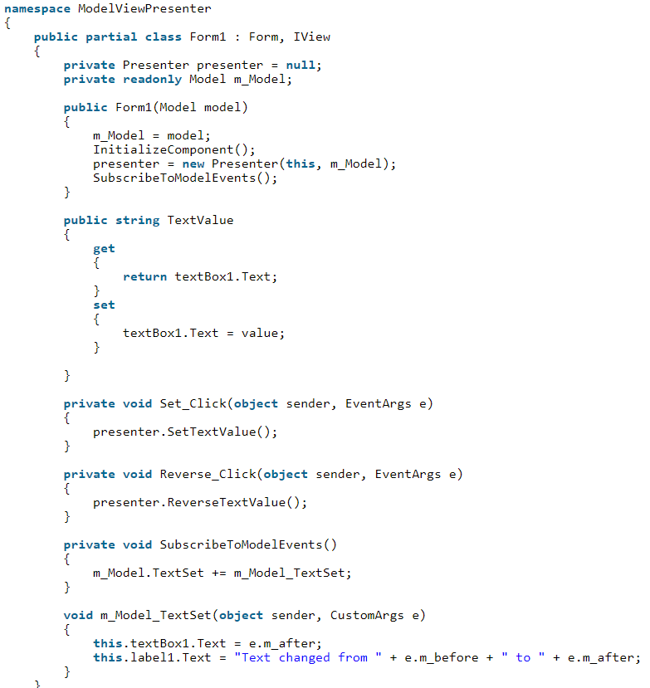
MVP Example
Model injection in constructor
Creates Presenter
http://www.technical-recipes.com/2015/the-model-view-presenter-pattern-in-c-a-minimalist-implementation/

Slide 60
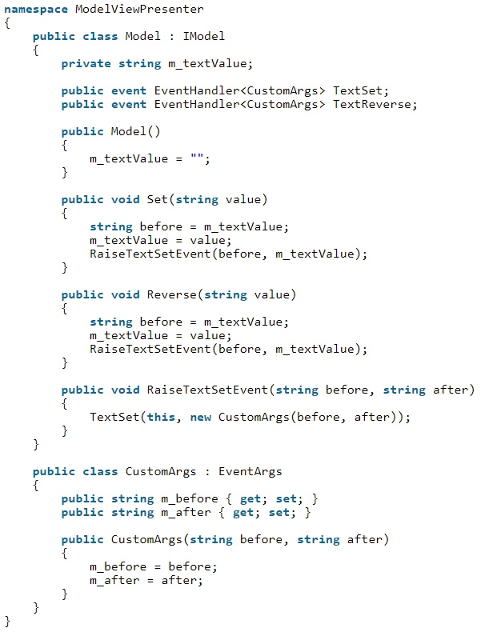
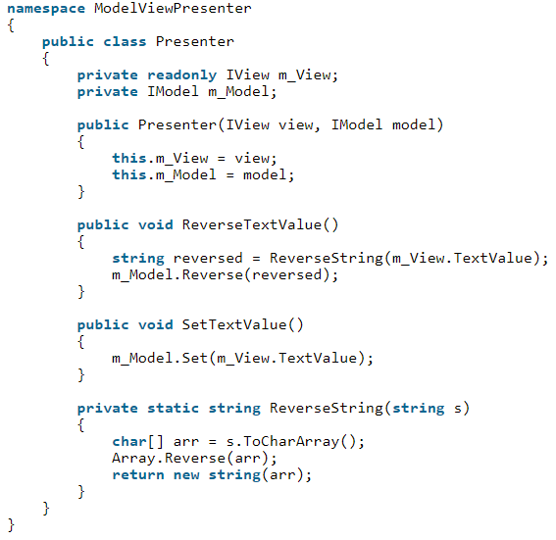

Slide 61
MVP Consequences
Testable components
Separation of concerns
Single Responsibility
Readable
Maintainable

Slide 62
MVVM
Motivation
Need to share a project with a designer, and flexibility for design work and development work to happen near-simultaneously
Thorough unit testing for your solutions
Important to have reusable components, both within and across projects in your organization
Flexibility to change the user interface without having to refactor other logic in the code base
https://www.wintellect.com/model-view-viewmodel-mvvm-explained/

Slide 63
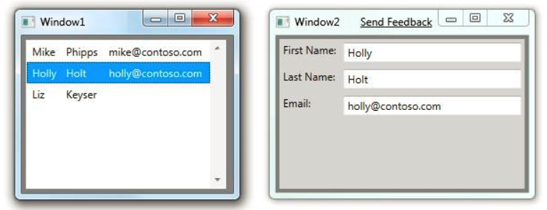
MV* Example [https://blogs.msdn.microsoft.com/ivo_manolov/2012/03/17/model-view-viewmodel-mvvm-applications-general-introduction/]
UI Contacts App

Slide 64
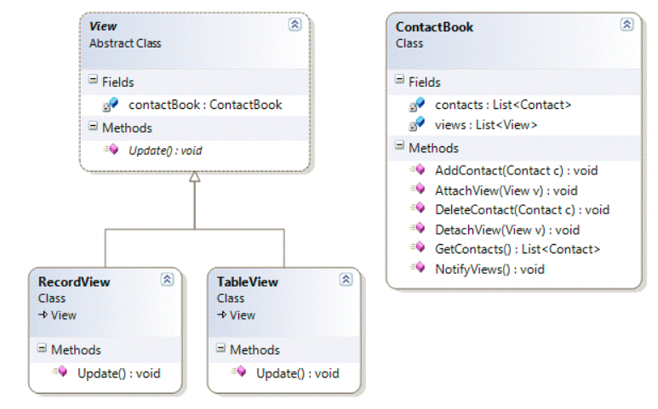
M-V separation
Instance of the Observer Pattern

Slide 65
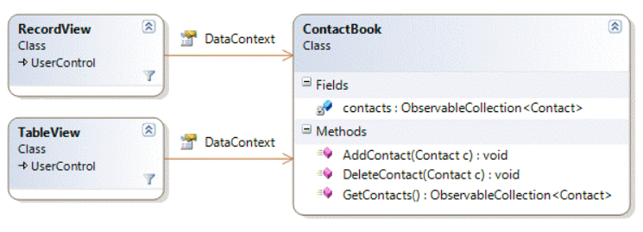
Simplistic WPF/Silverlight design
Databinding is the ability to bind UI elements to any data.
Commands provide the ability to notify the underlying data of changes in the UI.
New features:
1. Track the selected item, so that we update RecordView whenever the selection in TableView changes, and vice versa.
2. Enable or disable parts of the UI of RecordView and TableView based on some rule (for example, highlight any entry that has an e-mail in the live.com domain).

Slide 66
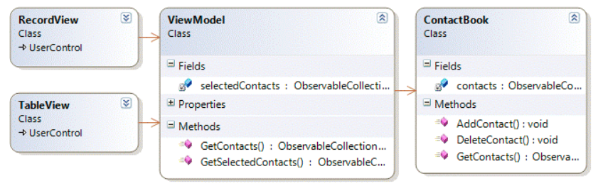
MVVM Design
The views know of the ViewModel and bind to its data, to be able to reflect any changes in it.
The ViewModel has no reference to the views—it holds only a reference to the model.
For the views, the ViewModel acts both as
a façade to the model,
a way to share state between views (selectedContacts in the example).
The ViewModel often exposes commands that the views can bind to and trigger.

Slide 67
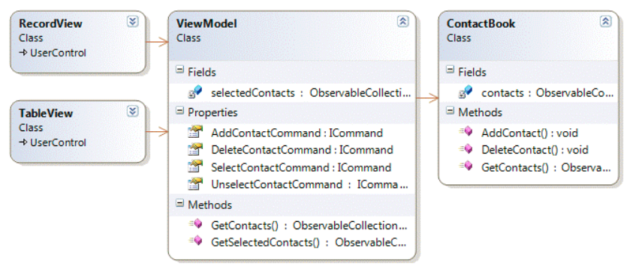
Commands in MVVM apps
Application of the Command Design Pattern

Slide 68
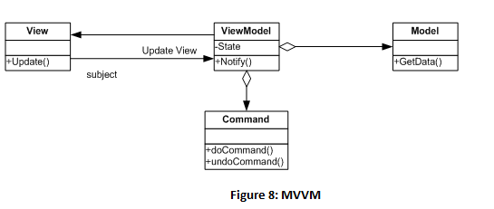
MVVM
https://www.wintellect.com/model-view-viewmodel-mvvm-explained/

Slide 69
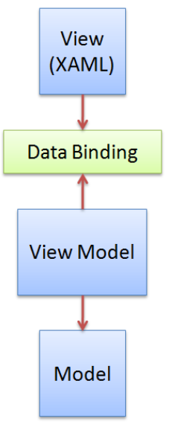
MVVM Structure
Model
Represents the data
2 perspectives
OO approach: Domain Objects
Data-centric approach: XML, DAL, etc.
No knowledge of how and where it will be presented
Implements INotifyPropertyChanged
ViewModel
Contains Properties, Commands, etc. to facilitate communication between View and Model
Properties that expose instances of Model objects
Commands and events that interact with Views for user interactions
Implements INotifyPropertyChanged
Pushes data up to the View

Slide 70
MVVM Structure
View
Visual display
Buttons, windows, graphics, etc.
Responsible for displaying data
Not responsible for retrieving data, business logic, business rules or validation
Contains binding extensions
Identify data points represented to the user
Point to the names of the data point properties

Slide 71
MVVM Interactions
Collaboration
Model = The data
View
Binding to ViewModel
Set DataContext to instance of ViewModel
ViewModel
Keeps state & behavior of View
Facade to Model
Abstraction of code-behind
No hard dependencies of View
Can be reused

Slide 72
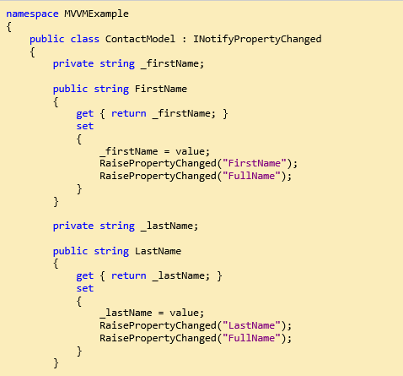
MVVM Code Example

Slide 73
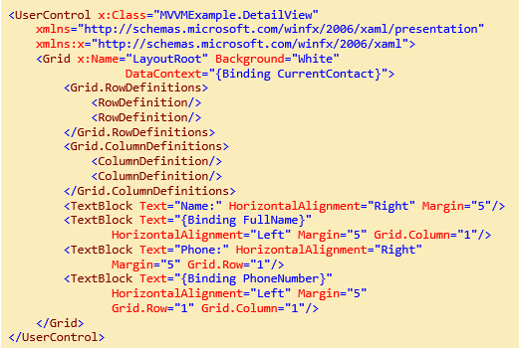
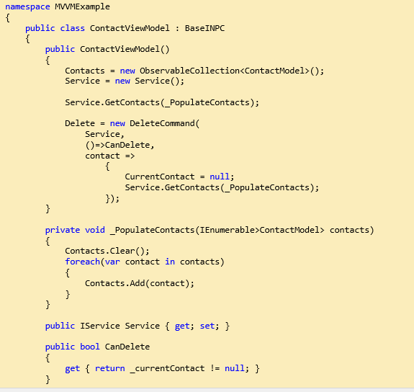

Slide 74
MVVM Discussion
MVVM is a derivative of MVC that takes advantage of particular strengths of the Windows Presentation Foundation (WPF) architecture
separates the Model and the View by introducing an abstract layer between them: a “View of the Model,” or ViewModel.
The typical relationship between a ViewModel and the corresponding Views is one-to-many, but not always.
There are situations when one ViewModel is aware of another ViewModel within the same application. When this happens, one ViewModel can represent a collection of ViewModels.

Slide 75
MVVM benefits
A ViewModel provides a single store for presentation policy and state, thus improving the reusability of the Model (by decoupling it from the Views) and the replaceability of the Views (by removing specific presentation policy from them).
MVVM improves the overall testability of the application.
MVVM also improves the “mockability” of the application.
MVVM is a very loosely coupled design. The View holds a reference to the ViewModel, and the ViewModel holds a reference to the Model. The rest is done by the data-binding and commanding infrastructure of WPF.

Slide 76
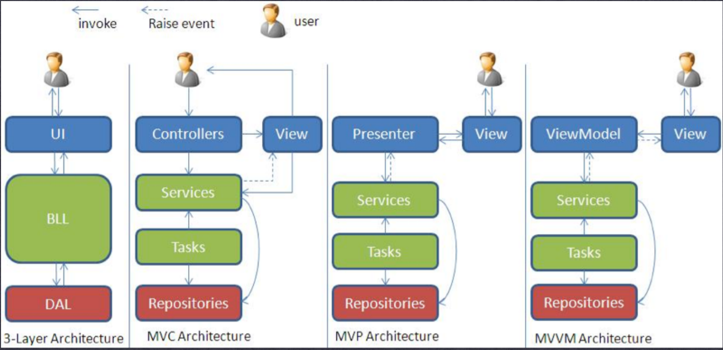
MV* in a Nutshell
http://merroun.wordpress.com/2012/03/28/mvvm-mvp-and-mvc-software-patterns-againts-3-layered-architecture/

Slide 77
Wrap-up
Architectural Patterns
High-level design of an architecture
Patterns may have several variants
Need to be adapted/customized for the specific needs
Use more basic design patterns

